Slide 1
Stereo Panorama Generation

Slide 2
Overview of the Project
The main problem aim of this project is to create depth perception from a given normal monocular panorama which has only a single viewpoint. To do this we take two images for each frame, one image corresponding to how the left eye will perceive that frame and the second image corresponds to how the right eye will perceive that frame as two perspectives are necessary for depth perception. Depth perception is an extremely important and an integral part of all virtual reality (VR) devices whose demand is gearing up in recent years. Along with depth perception , a complete 360° view is also necessary in VR devices, as a user can rotate their head to see around them, and hence a stereo panorama is required.

Slide 3
Understanding the Problems/Project
Extracting the right strip corresponding to the left eye and left strip corresponding to the right from each individual frame.
01
Generating two different panoramas, one formed by mosaicing all the right strips and the other formed by mosaicing all the left strips and then combining both the panoramas.
02
Creating a stereo panorama after applying automatic disparity control to control disparity.
03

Slide 4
Major Difficulty and Remedy
Creating a dataset was a very challenging task we had to accomplish. It was difficult because there were a couple of criterias which needed to satisfy. The criteria were:
Distance between optical center and axis of rotation should be 32cm.
The focus of the camera should remain constant throughout the video.
The camera should rotate 2-3 degrees per second.
It should cover 30 frames per second.
The researchers had constructed a special instrument in order to achieve this. Due to technical problems, we could not construct such instrument. Instead, what we did was we took images at every certain degree by making use of the fact that ultimately the video will be processed frame by frame which is nothing but an image.

Slide 5
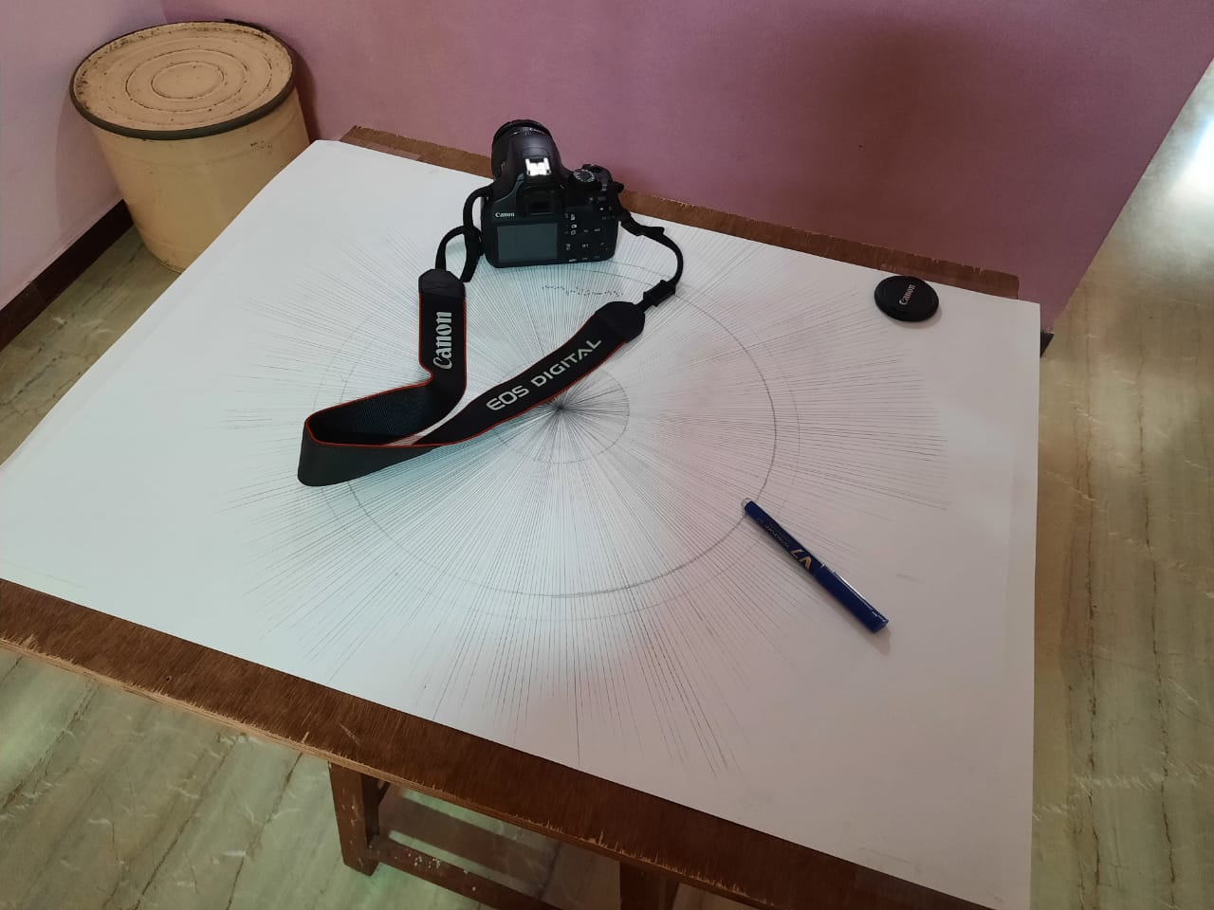
Current Progress
We created the input using a heuristic approach.
A line at every 1° difference was made(360 such lines). Concentric circles of radii 18 and 20 cm were made. The DSLR was place such that it's screen was tangential to the smaller circle, while the OC was placed on the larger circle. In the transition between 2 consecutive lines an average of 6-7 photos were taken. Thus achieving the results of a video taken steadily in a horizontal plane.

Slide 6
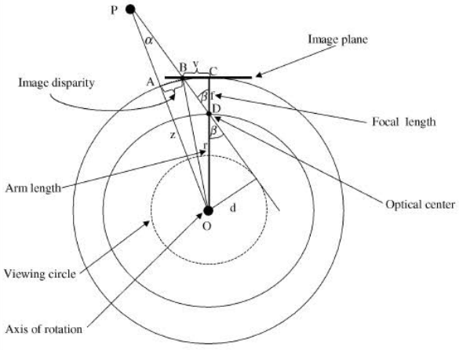
Current Progress
In the next step we calculated the optimal strip size and location which will provide decent disparity variation so that our eyes can fuse the images together.
For calculating strip size, we take inter eye distance to be 6.5 cm.
We then calculate the left and right locations from the center of image taking the left strip as reference.

Slide 7
Project timeline and Way Ahead
Dataset
Strip calculation
Merging strips
Disparity control
Final output
Created a dataset by a heuristic approach.
Implemented a code for extracting and calculating strips.
Merge all the strips and generate a panorama.
Implement disparity control algorithm.
Run the algorithm on the new output to get stereo panorama.

Slide 8
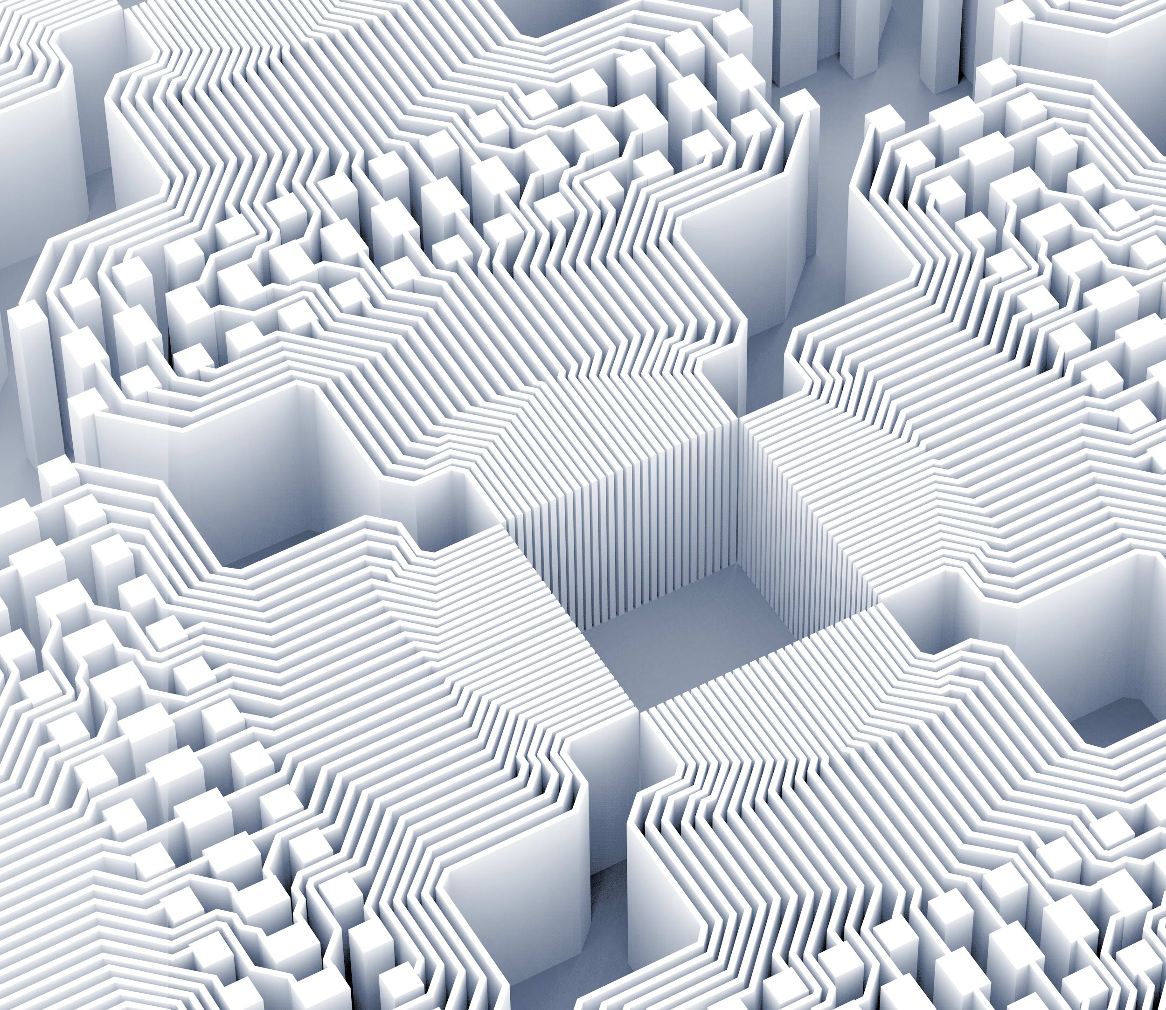
Thank you!
Made by:
Abhishek Shah (2018101052)
Mrinal Khubchandani (2018101053)
Sai Tanmay Reddy Chakkera (2018101054)
Tirth Upadhayaya (2018101069)

